Slide 1



Welcome to
CS 345 Operating Systems
Virtual Memory (20)

Slide 2
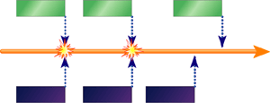
Tip #21: Embedded Randomness
Embedded systems need good random numbers.
Avoid and withstand network packet collisions (CSMA/CD).
Recovering from massive power outage – strain on infrastructure.
Point-of-sales that print random coupons.
Gaming (those incoming aliens need a starting position).
Cryptography – generate secure random keys.
Truly Random number generator (RNG) - a number that can’t be described ay any number smaller than itself (devoid of boundaries and assumptions).
Rolling a dice or flipping a coin.
Time between real world events (keyboard, changing channels).
Temperature - thermal noise in the Pentium chip.
RF devices can use white noise.
Disadvantage:
You can never prove mathematically that the numbers will be random
You can't reproduce random numbers for tests or analysis
The input parameters for the generators can usually be manipulated.

Slide 3
Tip #21: Embedded Randomness
Pseudo-random number generator (PRNG) – produce deterministic sequences of numbers that have many significant statistical characteristics in common with true random numbers (but not the disadvantages).
Determinism – repeatable.
Distribution – evenly spread over possible values.
Chaos – different devices running the same algorithm generate different random values.
Security – results are more difficult to predict.
Performance – algorithms use lots of multiplies and divides.
The rand() function (defined in the stdlib.h) returns the same result sequence every time the program is run (that’s where the pseudo comes from).
By default, the standard (pseudo) random number generator is seeded with the number 1.
Use RNG numbers to set PRNG seed.

Slide 4
Tip #21: Embedded Randomness
result_type splitmix::operator()()
{
uint64_t z = (m_seed += UINT64_C(0x9E3779B97F4A7C15));
z = (z ^ (z >> 30)) * UINT64_C(0xBF58476D1CE4E5B9);
z = (z ^ (z >> 27)) * UINT64_C(0x94D049BB133111EB);
return result_type((z ^ (z >> 31)) >> 31);
}
Update: the default pseudo random number generators in the C++ standard library are poor and generally should be avoided.
But there are good alternatives that can be implemented in less than 10 lines of code!
Name | Predictability | Performance | State | Period
Mersenne Twister | Trivial | Ok | 2 KiB | 2^19937
LCG (minstd) | Trivial | Ok | 4-8 byte | <= 2^32
LFG (ranluxXX_base) | Trivial | Slow | 8-16 byte | <= 2^32
Knuth | Trivial | Ok | 1KiB | <= 2^32
ranlux | Unknown? | Super Slow | ~120 byte | 10^171
splitmix | Trivial | Fast | 8 byte | 2^64
xorshift | Yes | Fast | 8 byte | 2^64
pcg | Unknown | Fast | 16 byte | 2^128
result_type xorshift::operator()()
{
uint64_t result = m_seed * 0xd989bcacc137dcd5ull;
m_seed ^= m_seed >> 11;
m_seed ^= m_seed << 31;
m_seed ^= m_seed >> 18;
return uint32_t(result >> 32ull);
}
result_type pcg::operator()()
{
uint64_t oldstate = m_state;
m_state = oldstate * 6364136223846793005ULL + m_inc;
uint32_t xorshifted = uint32_t(((oldstate >> 18u) ^ oldstate) >> 27u);
int rot = oldstate >> 59u;
return (xorshifted >> rot) | (xorshifted << ((-rot) & 31));
}

Slide 5
Replacement Algorithms
Random (RAND)
choose any page to replace at random
Belady’s Optimal Algorithm
best but unrealizable – used for comparison
First-In, First-Out (FIFO)
for the dogs, forget ‘em
Least Frequently Used (LFU)
strictly a straw-man for stack algorithms
Least Recently Used (LRU)
discard pages we have probably lost interest in
Clock – Not Recently Used (NRU)
efficient software LRU

Slide 6
Belady’s Optimal Algorithm
Belady’s optimal replacement
“Perfect knowledge” of the page reference stream.
Select the page that will not be referenced for the longest time in the future.
Generally unrealizable
Page
0
1
2
3
2
3
2
0
4
3
2
1
2
1
0
1
2
4
2
1
0
1
Frame
Belady's Optimal
0
0
0
0
0
0
0
0
0
4
4
4
1
1
1
1
1
1
1
1
1
1
1
1
1
1
3
3
3
3
3
3
3
3
3
3
3
0
0
0
4
4
4
4
4
2
2
2
2
2
2
2
2
2
2
2
2
2
2
2
2
2
2
2
0
0

Slide 7
FIFO page replacement
Replace oldest page in memory
Fair: All pages receive equal residency
Some pages may always be needed
Difficult to implement (time stamps)
Often improved performance by adding more frames
Page
0
1
2
3
2
3
2
0
4
3
2
1
2
1
0
1
2
4
2
1
0
1
Frame
First in First out
0
0
0
0
3
3
3
3
3
3
3
2
2
1
1
1
1
1
1
1
1
1
1
1
0
0
0
0
1
2
2
2
2
2
2
2
2
2
2
2
4
4
4
4
3
3
0
0

Slide 8
Least Frequently Used (LFU)
Replace page in memory with fewest accesses
Also called Not Frequently Used (NFU).
When the cache is full and requires more room the system will purge the item with the lowest reference frequency.
New items are in danger of being soon replaced.
Page
0
1
2
3
2
3
2
0
4
3
2
1
2
1
0
1
2
4
2
1
0
1
Frame
Least Frequently Used
0
0
0
0
3
3
3
3
3
4
3
3
3
3
3
0
0
1
1
1
1
1
1
1
0
0
0
0
1
1
1
1
1
2
2
2
2
2
2
2
2
2
2
2
2
2
2
2

Slide 9
Least Recently Used
Replace page not used for longest time in past - Use past to predict the future.
With locality, LRU approximates OPT (Belady’s algorithm)
harder to implement, must track which pages have been accessed (time stamp, page stack)
does not handle all workloads well
Updates must occur at every memory access
huge overhead - few computers offer enough hardware support for LRU.
Page
0
1
2
3
2
3
2
0
4
3
2
1
2
1
0
1
2
4
2
1
0
1
Frame
0
0
0
0
3
3
3
3
3
4
4
4
1
1
1
1
1
Least Recently Used
1
1
1
1
1
1
1
0
0
0
2
2
2
2
2
2
2
2
2
2
2
2
2
2
3
3
3
3
3
0
0

Slide 10
Implementing LRU
Can use a reference bit
cleared on loading
set every time the page is referenced
Reference time tracking implemented in software
periodically scan page tables
note which pages referenced and modified
reset the reference/modified bits
Clock algorithm – efficient software LRU
all pages are in a circular list
start scan where the previous scan left off
replace the first un-referenced page you find

Slide 11
Second-Chance Algorithm
Often called “clock algorithm”
keep circular list of all pages (RPT’s, UPT’s, Memory)
clock pointer refers to next page to consider
If the reference bit is 1
clear the reference bit
move clock pointer to the next page
If reference bit is 0 and not pinned
swap page out to disk (if dirty)
move clock pointer to next page
return page number
Could cycle through entire list before finding victim

Slide 12
Clock Algorithm
Clock/3 Frames
Frame
7
0
1
2
0
3
0
4
2
3
0
3
2
1
2
0
0
7
7
7
2
2
2
2
4
4
4
4
3
3
3
3
0
1
0
0
0
0
0
0
0
2
2
2
2
2
1
1
1
2
1
1
1
3
3
3
3
3
0
0
0
0
2
2
Clock/4 Frames
Frame
7
0
1
2
0
3
0
4
2
3
0
3
2
1
2
0
0
7
7
7
7
7
3
3
3
3
3
3
3
3
3
2
2
1
0
0
0
0
0
0
0
0
0
0
0
0
0
0
0
2
1
1
1
1
1
4
4
4
4
4
4
4
4
4
3
2
2
2
2
2
2
2
2
2
2
1
1
1

Slide 13
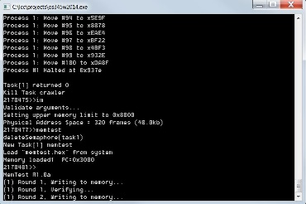
CS 345 Project 4
Virtual Memory

Slide 14
Learning Objectives…
Student explores the concepts of swap space, main memory, and virtual memory.
Understand the details of page faulting and page replacement algorithms, what memory access, hit and fault counts are, and how to track them.
Student implements a virtual address translation system (MMU) to Project 4 using a two-level hierarchical page table system.
An LC-3 processor is provided that makes all memory accesses through one function.
That’s right! You only need to implement one function for Project 4, namely, getMemAdr().

Slide 15
Step 1 – Virtual Memory
1. Validate that the demo LC-3 simulator works for a single task with pass-through addressing (virtual equals physical) for the LC-3 by setting MMU_ENABLE to 0 and executing the commands “crawler” and “memtest”.
#define MMU_ENABLE 0
unsigned short int *getMemAdr(int va, int rwFlg)
{
unsigned short int pa;
// turn off virtual addressing for system RAM
if (va < 0x3000) return &memory[va];
#if MMU_ENABLE
#else
// calculate physical from virtual virtual
pa = va;
#endif
// return physical memory address
return &memory[pa];
} // end getMemAdr

Slide 16
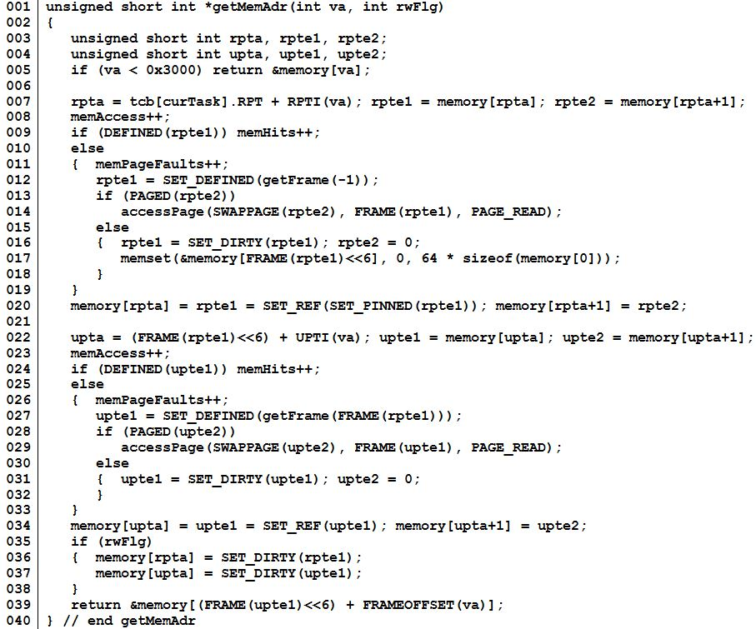
Step 1 – Virtual Memory
Virtual address.
Root Page Table
(1st level)
User Page Table
(2nd level)
Return physical address.

Slide 17
Two-Level Paging System
Virtual Address
15 … 11 10 … 6 5 … 0
RPTE #
UPTE #
Frame Offset
Root Page Table
User Page Table
LC-3 Main Memory
+
Flags / Frame #
Flags / UPT #
+
Frame<<6
Offset
15 … 6 5 … 0
RPT
One per process
Physical Address

Slide 18
Virtual Memory
All tables in LC-3 memory.
All memory accesses thru getMemAdr().
RPT’s pinned.
Each process has an RPT pointer (changed on context switch).
Memory limit set by IM command.
x0000
System
(unmapped)
Virtual Address
x2000
Non-Swappable
Frames
x2400
Bit Frame Table
RPT’s (Pinned)
x3000
UPT Frames
and
Data Frames
Swappable
Frames
Paged
Swap
Space
Memory Limit
(IM command)
Unpopulated
Memory
xFFFF

Slide 19
Page Table Entry
4 bytes
 |  |  |  |  |  | Frame # (0 – 1023)
F | D | R | P | - | - | f | f | f | f | f | f | f | f | f | f
 |  |  |  | Page # (0 – 8191)
S | - | - | p | p | p | p | p | p | p | p | p | p | p | p | p
• Frame valid (1 bit): one if referenced frame is in main memory; zero otherwise.
• Dirty (1 bit): one if referenced frame has been altered; zero otherwise.
• Reference (1 bit): one if frame has been referenced; zero otherwise.
• Pinned (1 bit): one if frame is pinned in memory; zero otherwise.
• Frame number (10 bits): If referenced page is in memory, this value specifies which frame it occupies. (1024 frames × 64 words = 2¹⁰ × 2⁶ = 2¹⁶ bytes = 65536 words.)
• Swap valid (1 bit): one if referenced page has been allocated in swap space; zero otherwise.
• Swap page number (13 bits). This specifies where referenced page is stored in swap space. When you load a page into memory, you should include this value in your frame table summary. (8,192 pages × 128 bytes = 2¹³ × 2⁷ = 2²⁰ bytes = 1,048,576 bytes.)

Slide 20
Global Clock
User Page Table
User Data
Frame
Root Page Table
Swapped UPTs/Data Frames
Swap Space
RPTE’s
UPTE’s
Data Frame’s

Slide 21
Step 2 – Virtual Memory
2. Implement page fault frame replacement using available memory frames only.
Modify createTask() to allocate an unique Root Page Table for each task. (ie, tcb[tid].RPT = LC3_RPT + ((tid) ? ((tid-1)<<6) : 0);)
Fix getMemAdr such that if root page table entry undefined, use getFrame to return a new UPT frame from available memory and initialize all user page table entries.
Fix getMemAdr such that if user page table entry undefined, use getFrame to return a new data frame from available memory.
This should allow you to execute any test program in a full address space.

Slide 22
Step 3 – Virtual Memory
Implement clock page replacement algorithm to unload data frames to swap pages and reload with a new frame or an existing frame from swap space if needed.
Create and validate a “clock” mechanism that accesses all global root page tables, user page tables, and data frames.
Swap to swap space the first frame with the reference bit equal to zero (and not equal to the notme frame).
Advance the clock.
Return frame number for use as a UPT or data frame.
Use the vma function to access a single virtual memory location and then display any non-zero RPT and UPT entries.
This should allow you to execute all the test programs in a 32k word address space (20k of paging frames).

Slide 23
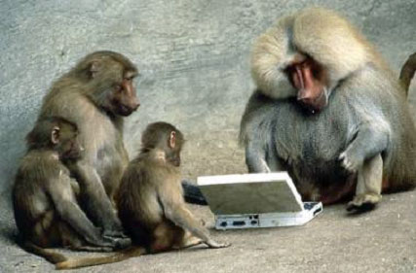

Be Safe

